Slide 1
Taking care of your own Health
DR Fulufhelo Tshivhula
Specialist Gynaecologist
62 Burger street
015 291 4310

Slide 2
specialist Obstetrics and Gynaecology ?
Dr with special education and expertise in the field of women’s health and reproduction.
He has the appropriate medical, surgical and obstetrical and gynaecologic knowledge and skills for the prevention, diagnosis and management of a broad range of conditions affecting women's reproductive health.

Slide 3

Obstetrics
The branch of medicine concerned with the treatment of women during pregnancy, labor, childbirth, and the time after childbirth.

Slide 4

Aims
To ensure that pregnancy culminates in the delivery of a healthy baby, without impairing the health of the mother.
Prevent maternal death and perinatal death and disability

Slide 5
Gynaecology
The branch of medicine specializing in the disorders of the female reproductive system.
Menstrual disorders, Menopause, infectious disease and maldevelopment of the reproductive organs, disturbances of the sex hormones, benign and malignant tumor formation,
Family planning and Infertility

Slide 6

Obstetrics and Gynaecology
Gynaecology
Obs/gyn
Mixed
Same

Slide 7
In Utopia every pregnancy would be intended and planned to occur at the optimum time for optimum outcome.
To strive towards this goal we need good health system, supported by Goverment, health professional , communities in larger
Not all Obstetric disasters can be anticipated or avoided.

Slide 8
Obsterics Disaster
Depression
Low self-esteem
Lack of Trust
Litigations
Divorces

Slide 9
How can this be avoided ?

Slide 10
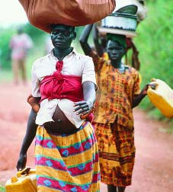

Slide 11
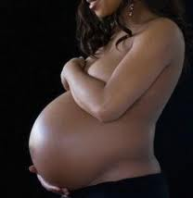
Antenatal care
Antenatal care is very important.
Make sure that the mother and the baby are more healthy as possible during pregnancy.

Slide 12
What happen during ANC visits?
It is recommended that mothers visit their local clinic or health professional to begin check-ups immediately after reliazing that she is pregnant.
Pregnant women can expect to be asked questions about their medical history, and have the following tests:
Blood pressure
Weight
Urine sample
Blood samples ( Blood group, HB, RPR and HIV)
Physical examination

Slide 13
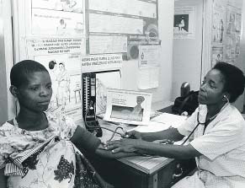

Slide 14
Top five causes of maternal death in RSA
Non-Pregnancy related infection (HIV/ AIDs)
Hypertension
Obstetric Haemorrhage
Pregnancy related sepsis
Pre-existing maternal diseases

Slide 15
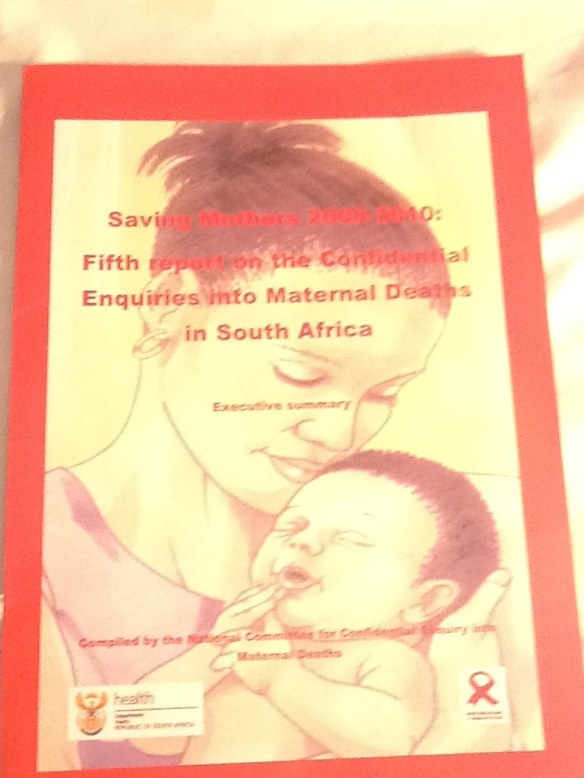

Slide 16
Every death counts

Slide 17
ANC represents an important entry point for different programmes and provision of integrated care
Antenatal care ( ANC)

Slide 18
The essential elements of a focused approach to antenatal care
Identification and surveillance of the pregnant woman
and her expected child
• Recognition and management of pregnancy-related
complications, particularly the one related to top cause of maternal death
• Recognition and treatment of underlying or concurrent
illness
• Screening for conditions and diseases such as anaemia,
STIs (particularly syphilis), HIV infection, mental health
problems, and/or symptoms of stress or domestic
violence

Slide 19
Advice and support to the woman and her family for
developing healthy home behaviours and a birth and
emergency preparedness plan to:
o Increase awareness of maternal and newborn
health needs and self care during pregnancy and the
postnatal period, including the need for social support
during and after pregnancy
o

Slide 20
Pregnancy
DO’s
Don’t
Booking
Nutrition
Supplements ( Folic, iron and calcium)
Exercise
Sex
Not booking
Alcohol
Smoking
Unknown medication
Visits malaria area
Avoid dehydration

Slide 21
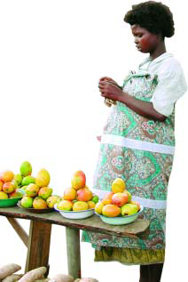

Slide 22
Delivery
Normal vaginal
Caesarean section
Should be the aim
This should be done with medical indication/ reason

Slide 23
Post Delivery
Breastfeeding
Supplements
Family planning
Gynaecology examination

Slide 24
Challenges
Attendance of ANC
Adequate Health facilities and easy assess
Well train health professional
Community education ( Know your rights )

Slide 25


Slide 26
Carcinoma of the Cervix

Slide 27
In RSA cervix cancer is the second most common cancer killer to our women, following Breast cancer

Slide 28
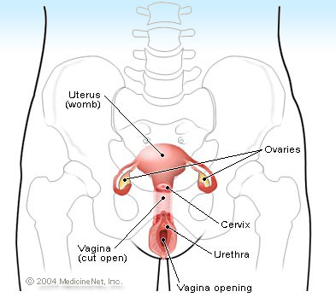
The cervix is the lower, narrow part of the uterus (womb). The uterus, a hollow, pear-shaped organ, is located in a woman's lower abdomen, between the bladder and the rectum. The cervix forms a canal that opens into the vagina, which leads to the outside of the body.

Slide 29
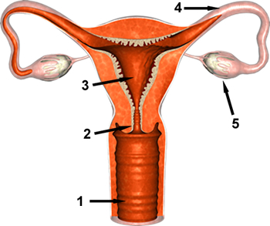
Anatomy of the Female Reproductive System
Cervix - region connecting the uterus to the vagina;

Slide 30
Statistic
Cancer of the cervix or cervical cancer is the leading cancer faced by South African women.
One in 35 women in South Africa will develop cervical cancer.
Although it is a preventable disease that is curable if detected in its early stages, more than 3 400 South African women die every year from cervical cancer
It is the leading cause of cancer deaths for South African women.

Slide 31
Risk factors
Women who begin having sexual intercourse before age 18
Many sexual partners increased risk for cervical cancer.
The relevance of sexual history is believe to have to do with the chance of infection with the human papillomaviruses (HPV), a sexually transmitted virus, which may trigger cervical cancer.
Smoking
Immunodeficiency.

Slide 32
Symptoms
Early cervical cancers usually don't cause symptoms.
When the cancer grows larger, women may notice one or more of these symptoms:

Slide 33
Symptoms
The most common symptom of cancer of the cervix is abnormal bleeding

Slide 34
Bleeding that occurs between regular menstrual periods
Bleeding after sexual intercourse, douching, or a pelvic exam
Menstrual periods that last longer and are heavier than before
Bleeding after going through menopause

Slide 35
Increased vaginal discharge
Fouls smelling discharge
Not responding to treatments

Slide 36
Late stage Symptoms
Pelvic pain
Pain during sex
Weight loss

Slide 37
Prevention
Regular pelvic exams and Pap testing can detect precancerous changes in the cervix

Slide 38
Risk factors
Women who begin having sexual intercourse before age 18
Many sexual partners increased risk for cervical cancer.
The relevance of sexual history is believe to have to do with the chance of infection with the human papillomaviruses (HPV), a sexually transmitted virus, which may trigger cervical cancer.
Smoking
Immunodeficiency.

Slide 39
Primary Prevention
Lifestyle changes
Postpone sexual activity to older age
Single partner
Use of condom
Stop smoking or never smoke
Vaccine

Slide 40
Secondary Prevention
Aims: Detect and treat of precursors cell.

Slide 41
Secondary Prevention
Screening
Pap Smears
RSA ( DOH) programme : free three Pap smears per lifetime
Commencing at age 30 years with 10 years interval

Slide 42
Pap smear First world
Initially smear should be taken soon after commenscement of sexual activity.
Then annually

Slide 43
What is a pap smear?
A pap smear is a quick, painless test used to detect early cell changes in the neck of the womb, which may later progress to cancer.
Cancer does not develop suddenly in the cells. There is a gradual change from normal, through various levels of abnormality, through pre-cancer and eventually to cancer.
The pap smear detects these along-the-way changes and indicates how far along that road a women has traveled.
Treatment can be given at an early stage and so prevent the later development of true cancer.

Slide 44
Where to go for a pap smear
Department of Health Services, or enquire at any local clinic.
All Gp’s
All gynaecologist

Slide 45
How is a pap smear done?
An instrument is placed into the vagina (speculum)and cells are scraped off the surface of the cervix with a wooden spatula.
The cells are put onto a glass slide which is then sent to the laboratory for examination under a microscope.
Should abnormal cells be detected, the client will be referred for treatment .

Slide 46
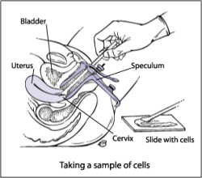

Slide 47
What happens if my Pap smear is abnormal?
Doctor may want to do another Pap smear or may want you to have a colposcopy.

Slide 48
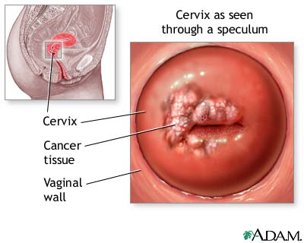

Slide 49
Colposcopy
A colposcopy gives a better look at your cervix and allows to take a sample of tissue (called a biopsy) in a area view to be more abnormal.

Slide 50
HPV in Man
Human papilloma virus (HPV) causes common warts, the small, white, beige or brown skin growths that can appear almost anywhere on the body and on the moist mucous membranes near the penis and anus
Genital warts

Slide 51
Fertility

Slide 52
Prognosis
With treatment, the 5-year relative survival rate for the earliest stage of invasive cervical cancer is 92%,
The overall (all stages combined) 5-year survival rate is about 72%.
With treatment, 80 to 90% of women with stage I cancer and 50 to 65% of those with stage II cancer are alive 5 years after diagnosis.
Only 25 to 35% of women with stage III cancer and 15% or fewer of those with stage IV cancer are alive after 5 years.^{[64]}

Slide 53
Treatment
The prognosis of cervical cancer depends upon the stage and type of cervical cancer and the tumor size.

Slide 54
Treatment
Hysterectomy
Radiotherapy
Chemotherapy

Slide 55
RE- Cap
Risk factory
Lifestyle change
Vaccination
Pap smear
Annually Gynae check-up

Slide 56
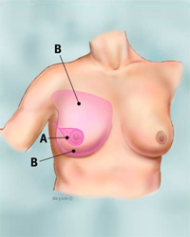
Breast Cancer
Cancer arising in breast tissue. Cancer is simply a group of abnormal cells that have abnormal growth patterns. Commonest cause of death in woman

Slide 57
Symptoms
Presence of a lump or thickening in the breast;
Swelling, dimpling, redness, or soreness of skin;
Change in shape or appearance of the nipple; and
Nipple discharge.

Slide 58
Self breast examination

Slide 59
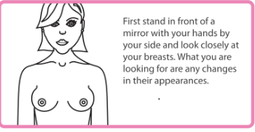

Slide 60
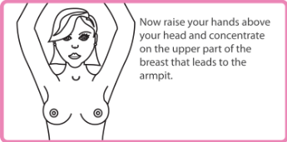

Slide 61
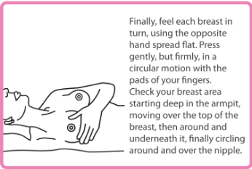

Slide 62
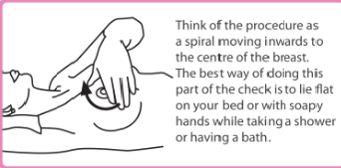

Slide 63
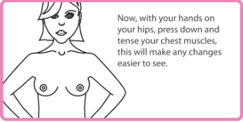

Slide 64
Death rates from breast cancer have been gradually declining and continue to decline. Increased awareness and screening and improved treatment methods.

Slide 65
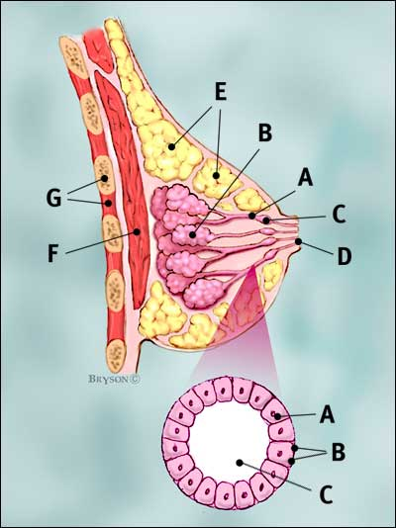

Slide 66
Menopause
Defines the time when a woman's reproductive life comes to an end and is marked by the end of her menstrual periods.

Slide 67
Menopouse
Decrease oestrogen level
Due decrease of seize of ovarian activity

Slide 68
Problems
Vasomotor activity
Hotflushes
Osteoporosis
Depression
Mood disorder
Dementia
Vaginal dryness

Slide 69
Suggested management
Enhance relaxation
Regular exercise
Maintain a healthy body weight
Keep cool
Don’t smoke and avoid alcohol , caffeine
Calcium supplements

Slide 70
Hormone supplements
Advantages
Disadvantages

Slide 71
Danger of not exercise in early days

Slide 72
Consequences of obesity in women at midlife
Increased risk of cardiovascular disease including coronary artery disease, hypertension and stroke
Increased risk of dementia
Increased risk of breast, uterine and colon cancer
Increased likelihood of depression
Greater likelihood of sexual dysfunction

Slide 73
Other factors influencing weight gain in midlife
Obesity in women is associated with poorer education, urbanization, inactivity, parity, family history of obesity and marriage at earlier age
There is a bi-directional relationship between obesity and depression
Many psychoactive medications are associated with weight gain
Chemotherapy is associated with an increase in total body fat and abdominal and visceral adiposity

Slide 74
The perimenopause and body composition (2)
A high waist circumference, indicating accumulation of excessive central abdominal fat, is an independent predictor of metabolic disease risk in postmenopausal women
These changes occur across all ethnic groups

Slide 75
The perimenopause and body composition (2)
A high waist circumference, indicating accumulation of excessive central abdominal fat, is an independent predictor of metabolic disease risk in postmenopausal women
These changes occur across all ethnic groups

Slide 76
Conclusion
The key to have a better life is on your life styles
Exercise
Diet

Slide 77


Slide 78
THANKS YOU
NDAA::
NDAAH

